Slide 1

DevOps & Cloud Infrastructure SEIS 665 Week 12
Jason Baker
Adjunct Instructor
Graduate Programs in Software
University of St. Thomas
St. Paul, MN

Slide 2
Agenda
Containers
Purpose and benefits
Containers vs. Virtual Machines
Docker
Overview
Docker client commands
Dockerfile
Images
Networking
Volumes

Slide 3








Fragile IT
Many different application
stacks
Analytics
Hadoop + pig + spark
Queue
Redis + redis-sentinel
Web API
Python + flask + celery + postgres
Static website
Nginx + bootstrap + jekyll
Many different hardware
environments
Production
servers
QA server
Developer
laptop
Development
Virtual machine
Public cloud

Slide 4
The Matrix from Hell
Static website | ? | ? | ? | ? | ?
Queue | ? | ? | ? | ? | ?
Analytics | ? | ? | ? | ? | ?
Web API | ? | ? | ? | ? | ?
 | Development VM | QA Server | Public Cloud | Production servers | Developer laptop

Slide 5
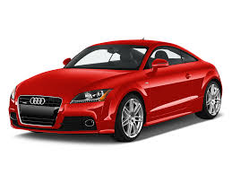
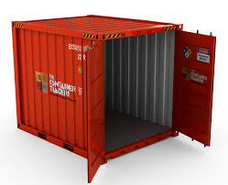
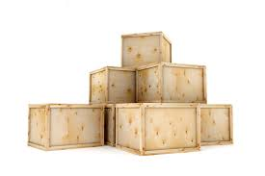
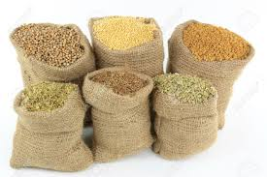

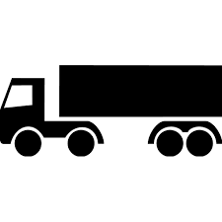

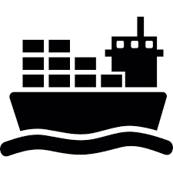


Transporting Cargo Pre-1960
Many different products
Many different transport
methods

Slide 6
Cargo Transport Matrix
 | ? | ? | ? | ? | ?
 | ? | ? | ? | ? | ?
 | ? | ? | ? | ? | ?
 | ? | ? | ? | ? | ?
 | ? | ? | ? | ? | ?

Slide 7

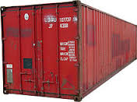
Intermodal Transport Solution
Intermodal shipping container
Shipping container sizes standardized
90% of all cargo shipped in standard containers
Can ship cars next to beans
Don’t need to worry about transitioning from ship to truck
5000 ships deliver 200M containers per year

Slide 8
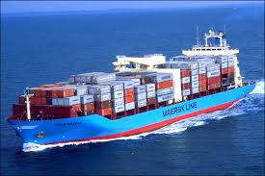
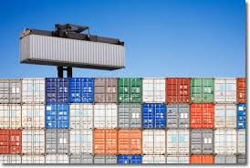
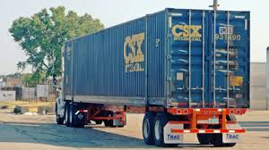
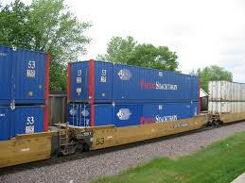
Intermodal Shipping Containers

Slide 9
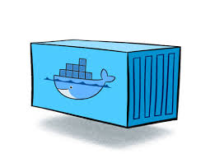
IT Transport Solution: Containers
Static website
Queue
Analytics
Web API
A container is the IT equivalent of a shipping container.
Encapsulates application stack in a lightweight and portable environment
Can be manually composed using simple operations
Runs on almost any hardware platform using a modern OS kernel
Development
Virtual machine
QA server
Production
servers
Developer
laptop
Public cloud

Slide 10
IT Matrix Solution
Static website | ? | ? | ? | ? | ?
Queue | ? | ? | ? | ? | ?
Analytics | ? | ? | ? | ? | ?
Web API | ? | ? | ? | ? | ?
 | Development VM | QA Server | Public Cloud | Production servers | Developer laptop

Slide 11
Developer Benefits
Build the application stack once and run it anywhere.
Eliminate concerns about compatibility on different hardware platforms.
The application will run in dev, testing, and at the customer site.
No worries about missing application dependencies like required packages.
Each application runs in its own container to eliminate conflicts like different shared libraries.
Easy to automate application testing and deployments using scripting.
Much less performance penalty than virtual machines.

Slide 12
IT Operations benefits
Configure the application once, run it anywhere.
Application lifecycle (develop/test/deploy) becomes much more repeatable
Eliminate inconsistencies between development, testing, and production environments
Simplifies continuous integration/deployment practices
Addresses performance and financial costs associated with virtual machines

Slide 13
Separation of Concerns
Developer
Focused on stuff inside the container
App code
Required libraries
Package management
Services
Data
Operations
Focused on stuff outside the container
Hardware/OS
Networking
Log management
Service monitoring
Developers can write awesome code and hand it off to operations in containers.
Operations doesn’t have to worry about the code, just the containers.

Slide 14
High Level Overview
A container feels like a lightweight VM.
You can log into it and get a shell.
It has its own process space.
You can run commands within the container as root.
You can install packages in the container.
The container can run services.
You can modify network settings in the container.

Slide 15
Low Level Overview
But… it’s not quite like a virtual machine.
It uses the host kernel.
It can’t run a different OS than the host.
It can’t load its own kernel modules.
It can’t emulate devices like usb, storage, etc.
Network using port forwarding
It doesn’t need to run OS-type processes like syslogd and cron.
It’s like chroot on steroids.
chroot = process jail that prevents the process from accessing external files outside an “apparent root directory”

Slide 16
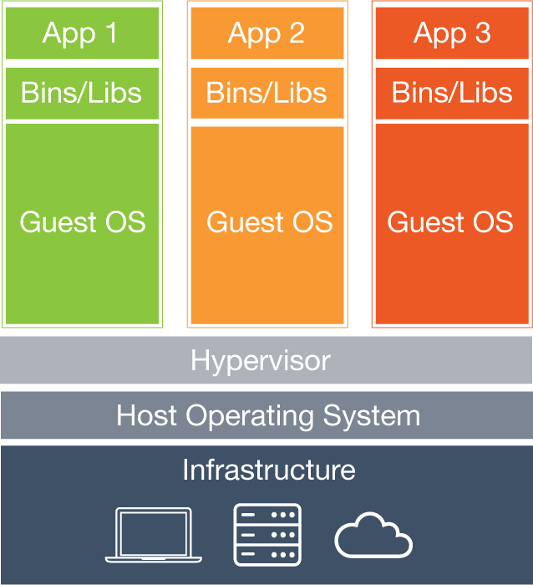
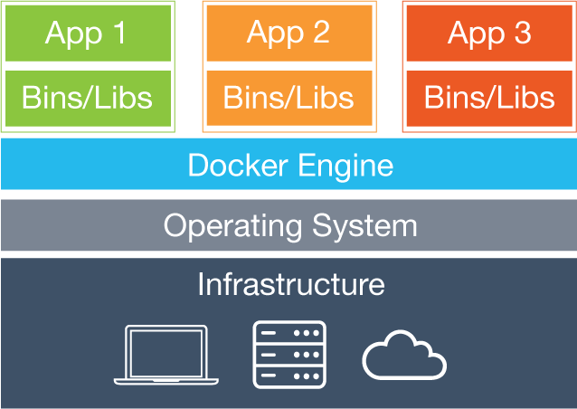
Virtual Machines vs. Containers
Key difference: Each virtual machine contains an OS whereas all containers share the same OS.

Slide 17
Container advantages over VMs
What can a container do that a VM cannot?
Really simple app deployment with a single command line.
“Boot” in a fraction of a second compared to a minute for a VM.
Enables very granular services (micro-service architecture).
Significantly reduce testing and development footprint.
Imagine the resource savings when launching hundreds of containers vs VMs.

Slide 18
Docker
An open-source Linux-based container implementation started by Solomon Hykes in France.
Initially released in 2013 and now in widespread use by cloud providers and enterprises.
It’s really an API and toolset that utilizes existing Linux facilities like cgroups and namespaces.
Docker wasn’t the first Linux-based container solution
Google developed cgroups 10 years earlier.
OpenVZ
Virtuozzo
But Docker was the first to develop a standardized exchange format.

Slide 19
Traditional vs. Docker Application Deployment
Traditional
Ship packages via rpm, gem, jar, etc.
Deal with dependency conflicts.
“Works on my machine.
Container
Ship containers with all dependencies.
Break application stack into layers and only ship layers that change.
“Works on any machine.”

Slide 20
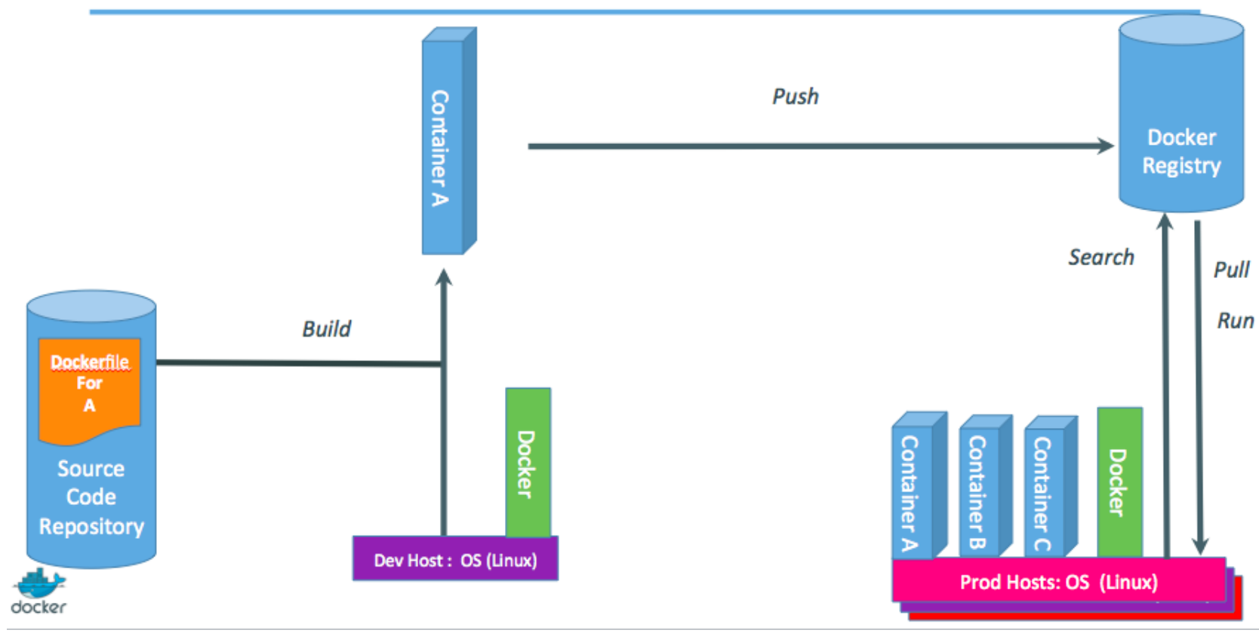
Development -> QA -> Production

Slide 21
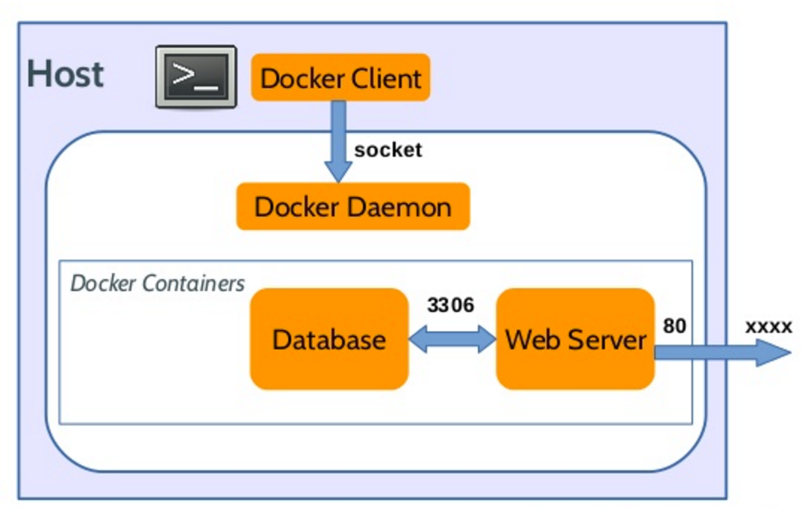
How Docker Works
Implemented as a client-server system.
Docker daemon (engine) runs on a host.
Daemon builds, runs, and manages containers.
Docker CLI is the client app.
Takes user input and sends it to the daemon.
CLI can run on the host or a different machine.
Docker Hub Registry
Collection of public images

Slide 22
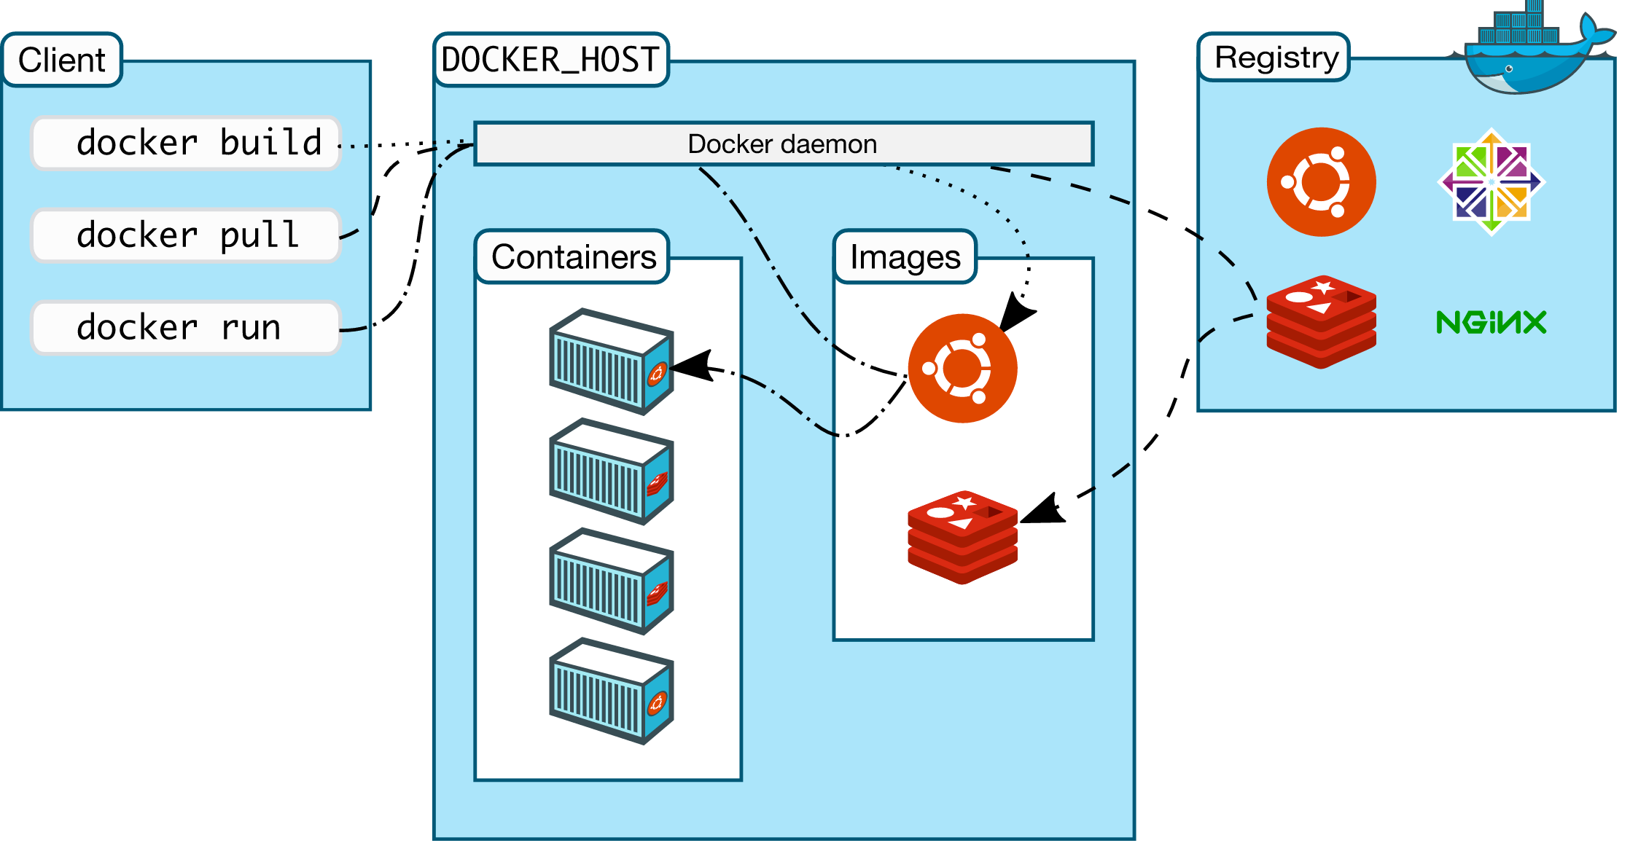
Start
Stop
Terminate

Slide 23
Docker Terms
Host: a machine running containers.
Image: a read only template containing files and meta-data used to create containers.
Container: an isolated application platform containing everything needed to run an application.
Registry: a repository of images.
Volume: data storage outside the container.
Dockerfile: a script for creating images.

Slide 24
Hello World Example
$ docker run busybox echo hello world
hello world
What’s happening here?
Docker created a small container using the busybox image (very small embedded system).
Ran a single process and echoed the text “hello world” using the docker run command.

Slide 25
Interactive Container
$ docker run –it ubuntu bash
root@42b6393c0d26:/#
Start up a minimal ubuntu system.
-i: connects to the container’s stdin (standard input)
-t: sets up a pseudo-terminal
We can install new packages while connected to the container.

Slide 26
Background Container
Containers can run in the background when started with the –d (detached) flag.
$ docker run –d jpetazzo/clock
116f074e161b365441f8444a21318068e987276011d3c02086f405702c65921b
What’s happening?
Docker downloads image jpetazzo/clock
We don’t see the output, but Docker logs it.
Docker responds with the ID of the container.

Slide 27
List Containers
The docker ps command works just like the Linux ps command and shows running containers.
Command output:
Container ID
Image used to create the container
How long the container has been running
The command running within the container.
$ docker ps
CONTAINER ID IMAGE COMMAND CREATED STATUS PORTS NAMES
116f074e161b jpetazzo/clock "/bin/sh -c 'while da" 12 minutes ago Up 12 minutes peaceful_jones

Slide 28
View Container Logs
Containers running in the background will log output to Docker.
Use the docker logs <id> command to view the logs.
$ docker logs 116f
Mon Sep 5 03:26:34 UTC 2016
Mon Sep 5 03:26:35 UTC 2016
Mon Sep 5 03:26:36 UTC 2016
Only need to specify the prefix of the container ID.
Use the –tail option to see the most recent # log output.
$ docker logs –tail 3 116f
$ docker logs –tail 3 –follow 116f

Slide 29
Stopping and restarting the container
Docker provides two ways to terminate the background container:
docker stop: graceful shutdown via TERM signal.
docker kill: forcibly stops using KILL signal.
$ docker stop 116f
116f
List all stopped containers using the –a option:
$ docker ps –a
Restart the container using the command:
$ docker start <container ID>

Slide 30
Docker images
Image is a collection of files and meta data.
Images made of up layers stacked on top of each other.
Each layer can add, change, and remove files.
Images can share layers to optimize disk, downloading, and memory use.

Slide 31
Images versus Containers
Image is a read-only filesystem.
Container is an encapsulated set of processes running a read-write copy of an image.
Utilizes copy-on-write to speed up boot time.
Images are templates you can create containers from.

Slide 32
Modifying Images
Images are read-only so it’s not possible to change an image.
However… we can do the following:
Create a new container from an image.
Make changes to the container.
Transform the changes into a new layer.
A new image is created by stacking the new layer on top of the old image.

Slide 33
Image namespaces
Images can have three namespaces:
Official images
Example: busybox
Maintained by Docker Inc. and containing many general utility images.
User images
Example: jpetazzo/clock
The first part denotes the Docker Hub user and the second part specifies the image.
Self-hosted images
Example: registry.mydomain.com:5000/wordpress
The docker client can push or pull images from a registry (Docker Hub or private repository).

Slide 34
Show current images
The docker images command shows what images are located on the host machine.
$ docker images
REPOSITORY TAG IMAGE ID CREATED SIZE
ubuntu latest bd3d4369aebc 9 days ago 126.6 MB
hello-world latest c54a2cc56cbb 9 weeks ago 1.848 kB
busybox latest 2b8fd9751c4c 10 weeks ago 1.093 MB
Search for images using the docker search command:
$ docker search hello-world

Slide 35
Installing images
Docker provides two ways to download images onto the host machine:
docker pull : explicitly downloads image
docker run : automatically downloads image if not found on the local host
$ docker pull debian:jessie
Pulling repository debian
b164861940b8: Download complete
b164861940b8: Pulling image (jessie) from debian
d1881793a057: Download complete
Docker downloads each layer of the image individually.

Slide 36
Image tags
Images have tags which define the versions of the image.
Different versions of Linux distributions.
Different version of application servers.
If a tag isn’t specified then the :latest tag is used.
It’s a good idea to specify a tag when the container is used in production.

Slide 37
Build an image
Start a new container:
$ docker run –it ubuntu bash
Install new packages on the container:
root@<id>:#/ apt-get update && apt-get install figlet
Exit the container
Inspect the container changes by using the docker diff command:
$ docker diff
C /root
A /root/.bash_history
C /tmp
C /usr
C /usr/bin
A /usr/bin/figlet
…

Slide 38
Build an image
Create the new image layer based on the changes using the docker commit command:
$ docker commit <container ID>
The output from the commit command is the new image ID.
$docker run –it 48da
root@3db4b8954811:/# figlet hello
We can also tag the image to make it easier to use:
$ docker tag <new image ID> figlet
$ docker commit <containerID> figlet

Slide 39
Dockerfile
Building Docker images by hand is tedious and error-prone.
A Dockerfile provides a recipe to build images using code in a text file.
The docker build –t <tagname> . command is used to build an image from a Dockerfile.
# Dockerfile
FROM ubuntu
RUN apt-get update -y
RUN apt-get install figlet -y
FROM specifies the base image
RUN lines are executed by Docker on the container during the build.
RUN commands must be non-interactive.

Slide 40
Building Dockerfile
$ docker build -t figlet .
Sending build context to Docker daemon 2.048 kB
Step 1 : FROM ubuntu ---> bd3d4369aebc
Step 2 : RUN apt-get update -y ---> Running in 6f1ae6f02080
…
Removing intermediate container 6f1ae6f02080
Sends build context ( . directory) to docker daemon as an archive.
Remote machine can build the image using local files.
A container (bd3d4369aebc) is created from the base ubuntu image.
The RUN command is executed and the container is committed to an image (6f1ae6f02080)
Intermediate container (6f1ae6f02080) is removed.
Docker builds up image and removes intermediate (temporary) layers during the process.

Slide 41
Caching system
If we run the Dockerfile build again, it will happen almost instantaneously.
Docker caches a snapshot of each intermediate image after each build step.
While executing a build, Docker checks to see if it has already built the sequence of commands.
You can force a rebuild using the docker build --no-cache command.
The docker history <image> command lists all the layers within an image.

Slide 42
Dockerfile command: FROM
FROM: defines the base image for the container.
Must be the first instruction after comments.
Lines starting with # are treated as comments.
Can be specified more than once to build multiple images.
FROM ubuntu
FROM training/sinatra

Slide 43
Dockerfile command: MAINTAINER
MAINTAINER: meta-data that specifies the owner/creator of the Dockerfile.
MAINTAINER Jason Baker <bake2352@stthomas.edu>

Slide 44
Dockerfile command: CMD
CMD : defines a default command to run when the container is started.
Can appear at any point in the Dockerfile.
Each CMD will override the previous one.
FROM ubuntu
RUN apt-get update
RUN apt-get install figlet
CMD figlet -f script hello
We can always override the CMD when running Docker by specifying a default command (bash):
$ docker run -t figlet bash

Slide 45
Dockerfile command: ENTRYPOINT
ENTRYPOINT : specifies a base command to run with optional parameters.
FROM ubuntu
RUN apt-get update
RUN apt-get install figlet
ENTRYPOINT ["figlet", "-f", "script"]
Command line arguments are appended to ENTRYPOINT parameters.
ENTRYPOINT can be located anywhere in the file.
$ docker run figlet awesome
The docker run --entrypoint option overrides the default entrypoint:
$ docker run –it --entrypoint bash figlet

Slide 46
Dockerfile commands
We can use CMD and ENTRYPOINT together.
ENTRYPOINT defines the base command, and CMD provides the default parameters if none are specified.
FROM ubuntu
RUN apt-get update
RUN apt-get install figlet
ENTRYPOINT ["figlet", "-f", "script"]
CMD hello world

Slide 47
Dockerfile command: COPY
COPY : copies files from the build context into the container being built, COPY <from> <to>
Create a file called hello.c in the container build directory:
int main () { puts("Hello, world!"); return 0; }
Create new Dockerfile:
FROM ubuntu
RUN apt-get update
RUN apt-get install -y build-essential
COPY hello.c /
RUN make hello
CMD /hello

Slide 48
Docker file command: WORKDIR
WORKDIR : sets the working directory for any RUN, CMD, ENTRYPOINT or COPY commands that follow it.
Can be used multiple times in a Dockerfile.
WORKDIR /a
WORKDIR b
WORKDIR c
RUN pwd
Output from this PWD command is /a/b/c

Slide 49
Dockerfile command: ENV
ENV : sets an environment variable key to a value.
Two formats:
ENV myName=“John Doe”
ENV myName John Doe
It is possible to override or set environment variables using docker run --env <key>=<value>

Slide 50
Dockerfile command: EXPOSE
EXPOSE : informs Docker that the container listens on the specified network ports at runtime.
Does not automatically make the ports available to the host at runtime.
Need to use the –p or –P flags when running container.

Slide 51
Docker container names
It’s easier to reference a container name than using the container ID.
Docker automatically assigns names: <mood>_<inventor name>
happy_curie
clever_hopper
Specify a name using docker run --name <name>:
$ docker run --name ticktock jpetazzo/clock
Docker will not create a contain if the specified container name already exists.
Rename a container using docker rename <oldname> <newname>

Slide 52
Networking
Containers can only have private IP addresses and services are exposed via ports.
Docker supports port mapping to allow external machines to access services running in containers.
$ docker run –d –P nginx
The –P publishes the container to make it reachable from other computers.
$ docker ps
CONTAINER ID IMAGE ... PORTS a386440e6859 nginx 0.0.0.0:32769->80/tcp, 0.0.0.0:32768->443/tcp

Slide 53
Networking
We can view the port mapping for a specific port in a container by running the command docker port <container ID> <port #>:
$ docker port a386 80
It is possible to manually allocate port numbers to a container using docker run –d –p 80:80 nginx
The format is host port:container port
Use the docker inspect command to find the IP address:
$ docker inspect --format '{{ .NetworkSettings.IPAddress }}' a386

Slide 54
Networking
A container can operate in a particular networking mode (called a driver).
Bridge (default)
Container gets a virtual eth0 interface (172.17.0.0/16 private IP address).
Connected to Docker bridge.
Container can have own routes, iptables, etc.
Null
Container has no network -- useful for isolated workloads.
Host
Container access network interfaces of the host and binds to its ports.
Native performance.
Container
Re-uses the network stack of another container and shares IP address, routes, iptables, etc.

Slide 55
Networking
Docker uses the notion of networks to create a virtual network infrastructure between containers.
Networks can be local or global and each network as an IP subnet.
Use the docker network ls command to view the current networks setup on the host.
Create a new network using the docker network create <name> command.
Launch new containers on the new network:
$ docker run -dit --name db1 --net prod alpine sh
$ docker run -it --name web1 --net prod ubuntu

Slide 56
Volumes
Any data created inside a Docker container disappears when the container stops.
We use volumes to persist data outside of the container – they exist independently.
$docker run –d –v ~/html:/usr/share/nginx/html –p 8000:80 nginx
The –v flag specifies a volume mount point
Format is [host-path]:<container-path>:[rw|ro]
Volumes are read-write by default.

Slide 57
Volumes
We can also declare volumes inside a Dockerfile using the VOLUME instruction.
VOLUME /var/lib/postgresql
Where is the mapping? Volumes don’t have to be anchored to a specific path! Use docker volume ls command to show volumes.
Also, we don’t want to map volumes in a Dockerfile because of portability issues.
Volumes bypass the Docker copy-on-write and have native I/O performance.
Docker commits don’t pull in volume data.
Containers can share the same volumes using the –volumes-from flag:
$ docker run –it --name alpha –v /var/log/ ubuntu bash
$ docker run --volumes-from alpha ubuntu bash

Slide 58
Docker Compose
Dockerfiles can become fairly complex and can only specify configuration for one container.
Docker Compose supports the building of multiple containers with a YAML file.
docker-compose.yml
version: '2'
services:
web:
build: .
ports:
- "5000:5000"
volumes:
- .:/code
depends_on:
- redis
redis:
image: redis

Slide 59
Troubleshooting Containers
How do you access a container to troubleshoot it?
Use the docker exec command to run a new process inside an existing container.
$ docker exec –it web1 bash

Slide 60
Docker Hub
We can upload images to the Docker Hub and make them publically or privately accessible.
Docker Hub images can be utilized by multiple systems.
Use the docker push username/imagename command to push images to Docker Hub.

Slide 61
Other Container Technologies
Google Container Engine
Microsoft Containers
FreeBSD jails/ Solaris zones
Some vendors offer “containers” that are really slimmed down VMs (VMWare Integrated Containers).
Kubernetes: build and manage server clusters to quickly deploy containers
Rancher OS: dedicated container host server

Slide 62
Homework
Assignment 11
Read Infrastructure as Code Chapter 15
Read How Cloud Has Changed The Data Center Architect (article)
Read 6 Models Of The Modern Data Center (article)

